Slide 1
CrFuzz: Fuzzing Multi-purpose Programs through Input Validation
Suhwan Song*, Chengyu Song$\text{†}$, Yeongjin Jang‡, Byoungyoung Lee*
*Seoul National University
$\text{†}$UC Riverside
‡ Oregon State University

Slide 2
Summary
CrFuzz is an efficient multi-purpose program fuzzer
CrFuzz can automatically check the validity of input and can be easily equipped to most of generic fuzzers.
CrFuzz uncovered 277 new vulnerabilities in various software programs.

Slide 3
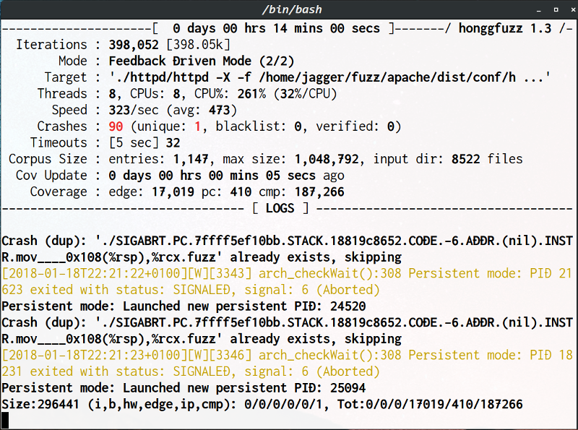
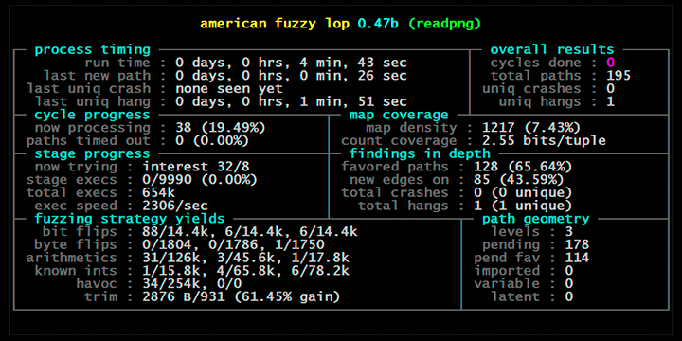
Fuzzing is a popular way to find software bugs
honggfuzz
ClusterFuzz
Libfuzzer
AFL
OSS-Fuzz

Slide 4
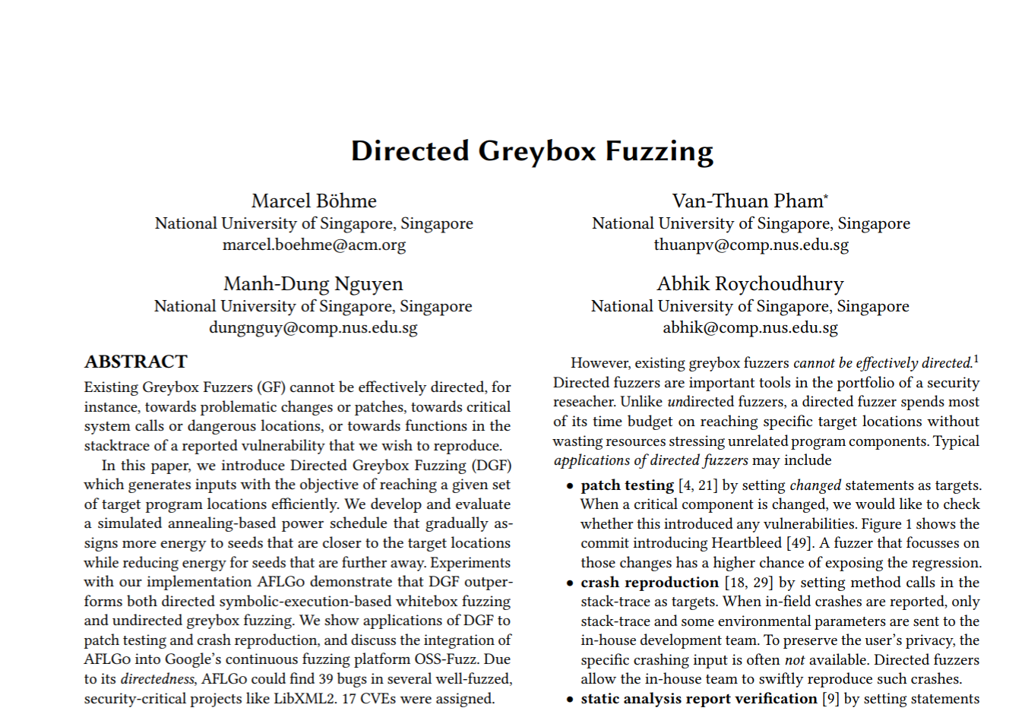
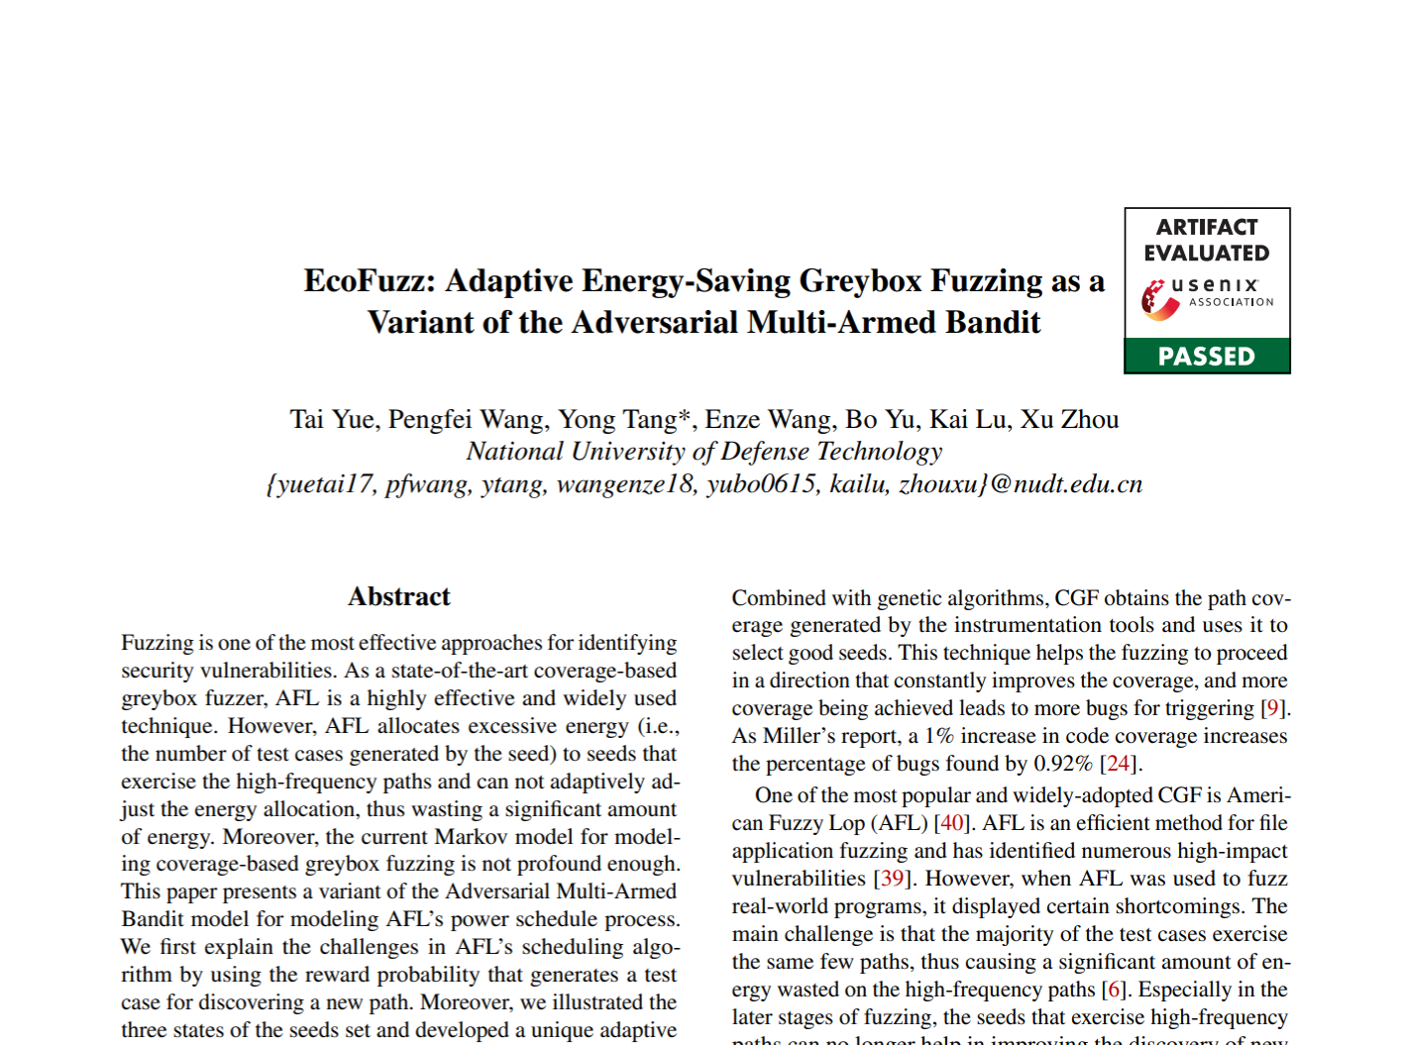
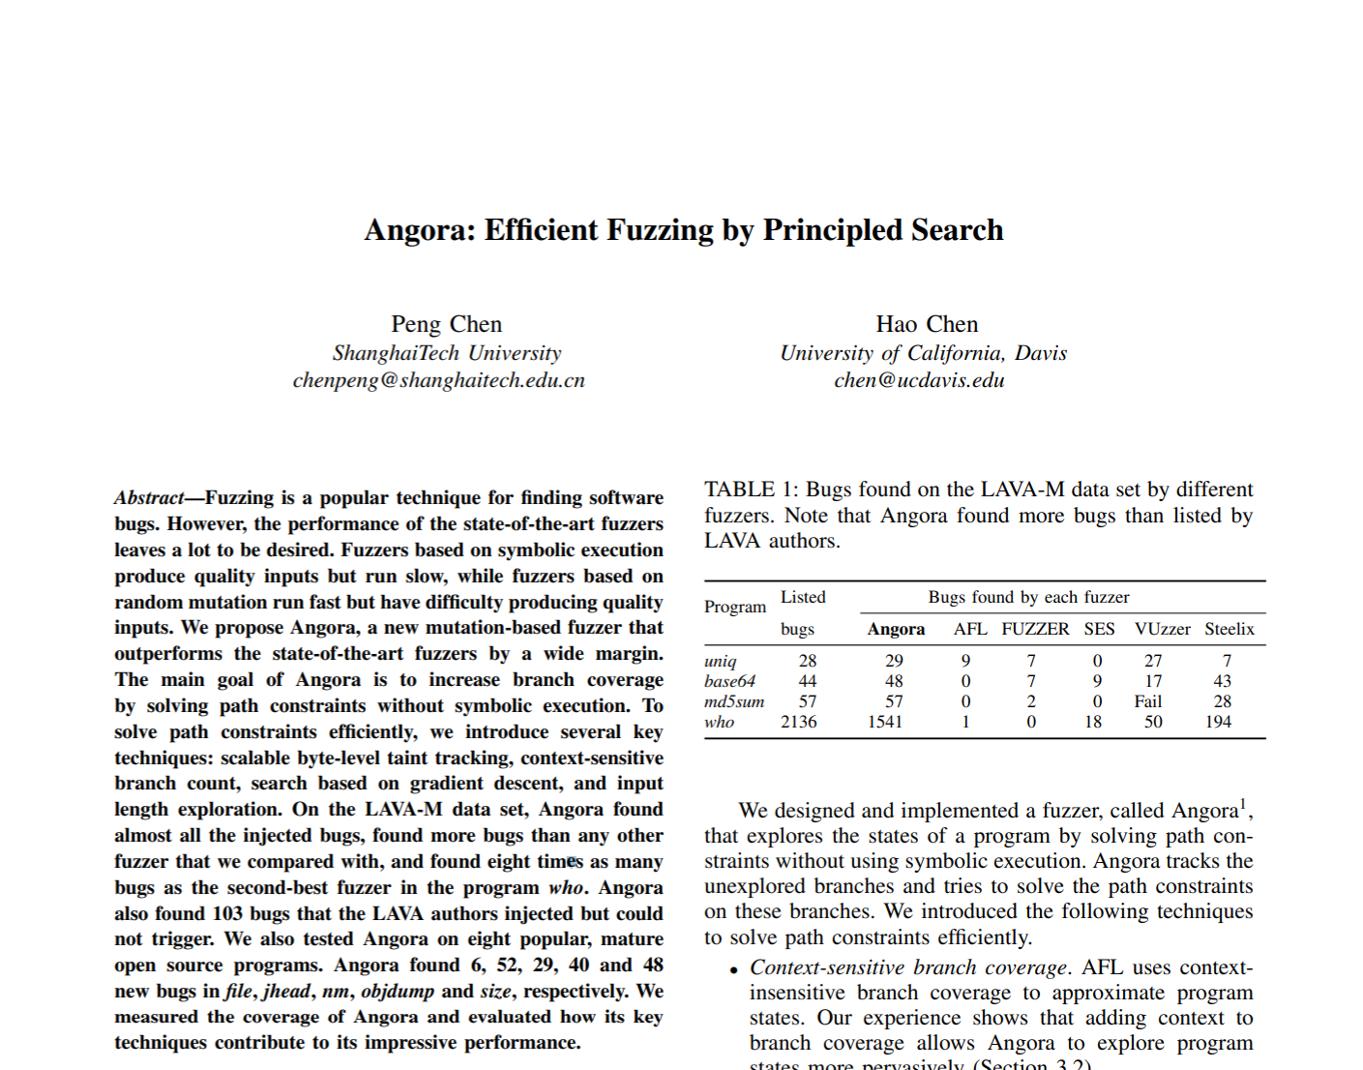
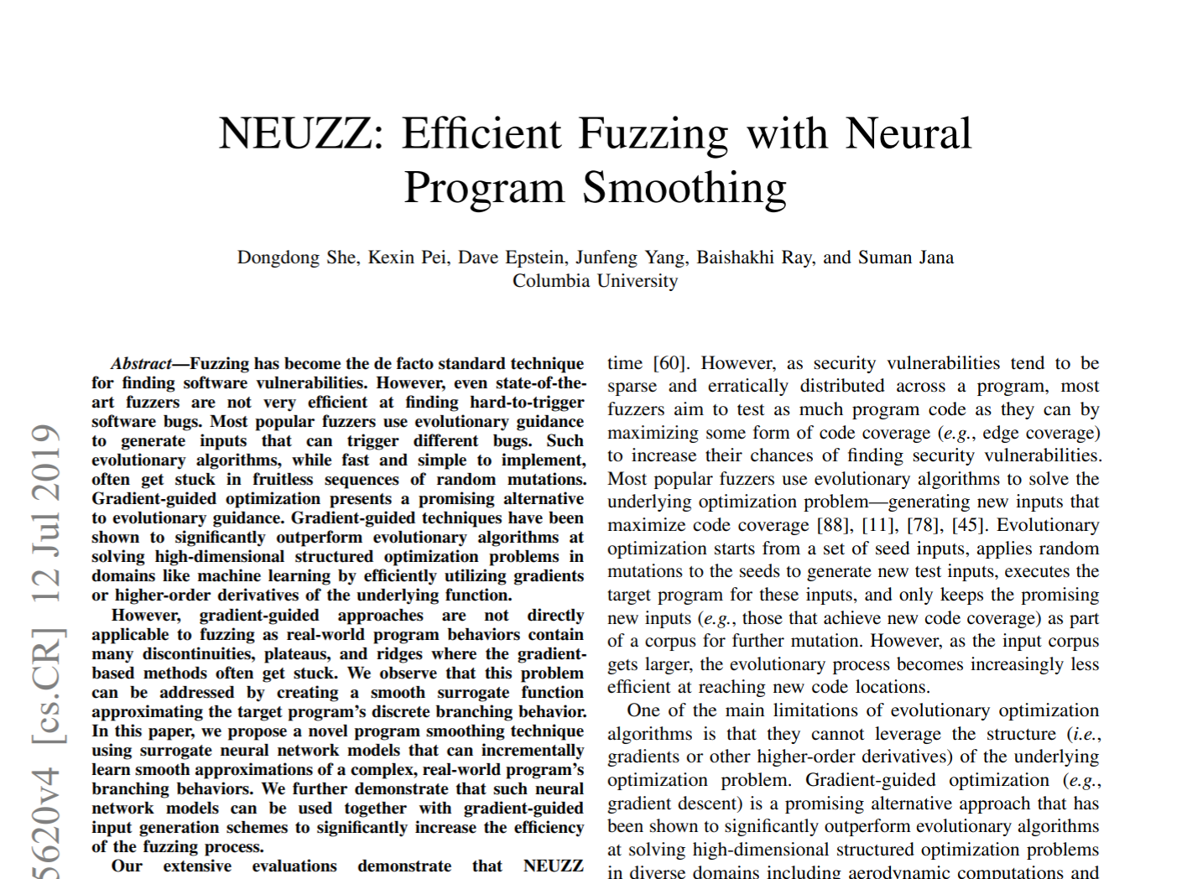
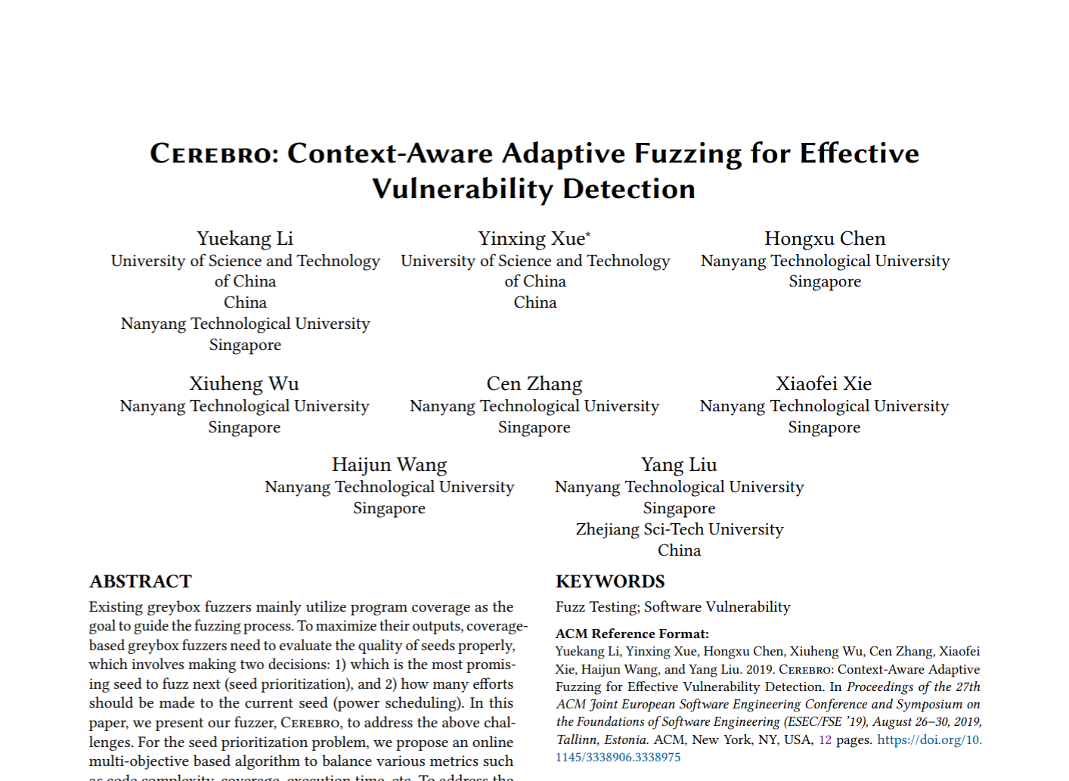
Coverage-guided Fuzzing
AFL
If new coverage
Input
Mutated Input
Program
Bug
Seed Corpus
Notes:
Icons made by <a href="https://www.flaticon.com/authors/freepik" title="Freepik">Freepik</a> from <a href="https://www.flaticon.com/" title="Flaticon"> www.flaticon.com</a>

Slide 5
Hidden Assumption of Coverage-guided Fuzzers
Current Fuzzers are designed to fuzz single-purpose programs
They fixed only one command-line option
If new coverage
Cannot well handle multiple command-line options
CMD
Input
Mutated Input
Program
Seed Corpus

Slide 6
Why not suitable for multi-purpose program fuzzing?
The combinations of file inputs and command-line options are numerous.
Majority of these combinations are meaningless to test.
Difficult to identify meaningful combinations!

Slide 7
Many Programs are Multi-purpose Programs

Slide 8
How Multi-purpose Program Works
BMP to JPEG
Coverage of “BMP to PNG”
BMP to PNG
File Input Parser
PNG
JPEG
PDF
File Input
[BMP]
File Input
[BMP]
Output
Output
Multi-purpose Program
Coverage of “BMP to JPEG”

Slide 9
Naïve Approach to Fuzz Multi-purpose Programs
Enumerate all CMDs for each mutation
If new coverage
CMD #1
Inefficient due to invalid input
CMD #2
Input
Program
Seed Corpus
Mutated Input

Slide 10
Invalid input is early rejected by the parser
Cannot reach to backends regardless of command-line options!
BMP to JPEG
Coverage of “BMP to PNG”
BMP to PNG
File Input Parser
PNG
JPEG
Same!
PDF
Invalid File Input
[BMP]
Output
Output
Multi-purpose Program
Terminate
Coverage of “BMP to JPEG”

Slide 11
Only valid input can explore backends
Should run all command-line options only with valid input!
BMP to JPEG
File Input Parser
PNG
JPEG
Valid File Input
[BMP]
PDF
Output
Multi-purpose Program
Coverage of “BMP to JPEG”

Slide 12
Important to distinguish invalid & valid input
Invalid input will take same coverage regardless of command-line options
Valid input can explore backends based on command-line options
Invalid File Input
[BMP]
Coverage of “BMP to PNG”
Coverage of “BMP to JPEG”
Valid File Input
[BMP]
Coverage of “BMP to PNG”
Coverage of “BMP to JPEG”

Slide 13
CrFuzz: an efficient multi-purpose program fuzzer
If new coverage
`
`
`
CMD Selector
CMD #1
CMD #2
CMD #3
If invalid, skip other CMDs
Input
Mutated Input
Program
Validity Checker
Seed Corpus

Slide 14
Validity Checker: Clustering analysis to determine if a given input is valid or not.
Valid Inputs
Clustering
Mutated Input
Invalid Inputs
Validity Checker

Slide 15
Coverage as a Cluster Feature
[x1, x2, x3, … , x65536]
[x1, x2, x3, … , x65536]
Coverage Map
[x1, x2, x3, … , x65536]
Coverage Map
[x1, x2, x3, … , x65536]
Coverage Map
Clustering
Coverage Map

Slide 16
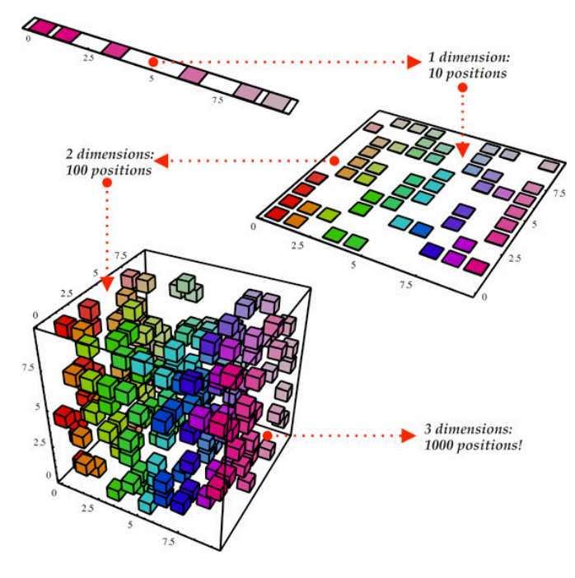
Limitation of Coverage as a Cluster Feature.
Coverage Map
[x1, x2, x3, … , x65536]
High dimension!
Notes:
http://www.turingfinance.com/artificial-intelligence-and-statistics-principal-component-analysis-and-self-organizing-maps/

Slide 17
Validity Pair as a Cluster Feature
High dimension to low dimension (2-d)
coverage dissimilarity between invalid input and given input
Invalid Input Coverage
[$v_{1}, v_{2}$]
Coverage Map
Valid Input Coverage
[x1, x2, x3, … , x65536]
coverage similarity between valid input and given input

Slide 18
How Validity Checker Works
Valid Input Reference
Invalid Input Reference
Reference Coverage of Valid Inputs
Reference Coverage of Invalid Inputs
High dimension!
Valid Cluster
Valid File Input
Coverage
converted to 2-d
Decision Boundary
High dimension!
Validity Pair Converter
Invalid Cluster
Invalid File Input
Coverage

Slide 19
Implementation
Modify AFL, QSYM, Mopt to support multi-purpose program fuzzing
Instrument CrFuzz on top of modified three fuzzers: AFL, QSYM, Mopt
CrFuzz technique can be easily applied to most of fuzzers.
AFL
QSYM
CrFuzz
MOpt

Slide 20
Evaluation
Research Questions
RQ1. Accuracy of Validity Checker
RQ2. Fuzzing Efficiency of CrFuzz
RQ3. New Vulnerabilities Found by CrFuzz

Slide 21
Accuracy of Validity Checker
Evaluated ffmpeg(FFmpeg), tiff2ps(libtiff), gs(Ghostscript).
Overall FP is always less than 1%.
The range of FN is from 0.2% to 2%.

Slide 22
Fuzzing Efficiency of CrFuzz
Path Coverage Evaluation with Three Command Line Options
Edge Coverage Evaluation with Three Command Line Options [See Paper]
Efficiency While Varying Command Line Options

Slide 23
Path Coverage Evaluation with Three Command Line Options
AFL+CrFuzz achieves 17.4% more path coverage than original fuzzer.
MOpt+CrFuzz achieves 21.5% more path coverage than original fuzzer.

Slide 24
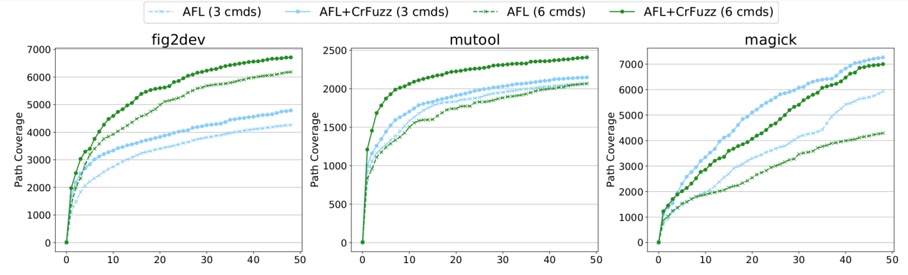
Efficiency While Varying Command Line Options
Performance advantage gap is increased more as more command line options are given

Slide 25
CrFuzz uncovered 277 new vulnerabilities in various software programs.
153 Vulnerabilities in FFmpeg
49 Vulnerabilities in GhostScript
42 Vulnerabilities in ImageMagick
212 of them are fixed!
14 Vulnerabilities in XFig
8 Vulnerabilities in libsixel
11 Vulnerabilities in MuPDF, GM…

Slide 26
Conclusion
We propose an efficient multi-purpose program fuzzer
We applied a clustering analysis to predict if a new input file would be accepted by a target program or not
CrFuzz-augmented fuzzers have shown reasonable better coverage as well as uncovering 277 new vulnerabilities in various software programs.

Slide 27
Thank you!

